Slide 1

AutoSWE Automating Society of Women Engineers Outreach Tool
Yongji Li
05/05/2016

Slide 2
OVERVIEW
Introduction
Similar Work
Requirements
Architecture and Design
Testing
Demo
Future work
References

Slide 3
Introduction
Why this app?
Since the year of 2008, android has become the most popular OS between four major mobile operating systems (android, windows, iOS and blackberry). Android is an open source and free to use platform. It provides the developers a broad way to develop various kinds of apps and only for this reason it is one of the most highly demanded OS for mobile technologies. In the summer semester, a fellow student at Texas Tech university has built an android app which can be used to create and administer surveys for SWE outreach events. I am very much interested in continuing her work to have a better understanding of android fundamentals. So I add new functionalities to meet the SWE outreach requirements

Slide 4
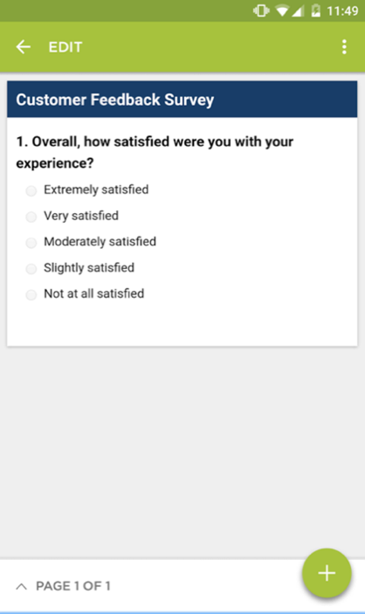
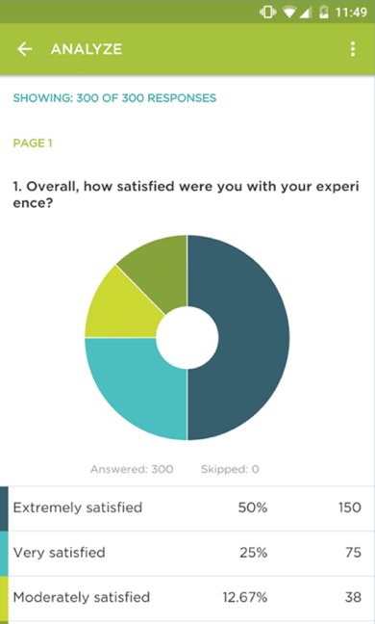
Similar Work
Survey Monkey app-World’s leading survey platform

Slide 5
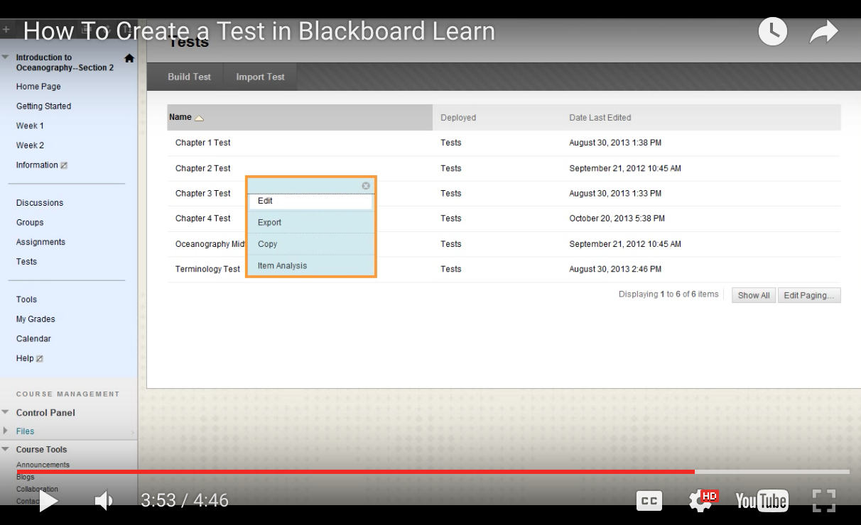
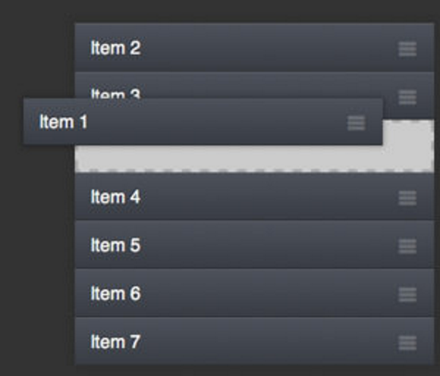
Similar Work
2. Test and survey section of blackboard learn website
The work flow
3. Drag-and-Sort ListView Library
It is useful for all kinds of prioritized lists: favorites, playlists, checklists, etc

Slide 6
Requirements
I extracted requirements from “SWE Needs Analysis for the Outreach Assessment Phone Application and Website”.
 | Functional Requirements | Nonfunctional Requirements | Data Requirements
user-level | Administrator Requirements Coordinator Requirements Non-Admin user Requirements | Availability Privacy Integrity Usability | Read User Information
operational-level | Registration operation Login operation Control Workshop activities | Performance and Safety | Check Email Format Check Password Format
physical-level | Set user`s data Password | Responsive design | File`s format

Slide 7
Functional Requirements-User Level
Admin users shall be able to register to the app.
Admin users shall be able to login to the app after registration is completed.
Admin users shall be able to change the password if necessary.
Admin users shall be able to create a survey.
(5) admin users shall be able to edit or delete survey data i enter in case of mistaken, incomplete, or other issue entries.
Admin users shall be able to deploy a survey.
(7) all users shall be able to take a survey.
(8) admin users shall be able to view survey results of each outreach event.
Admin users shall be able to see the list of survey pool.
(10) admin users shall be able to see the list of deployed survey pool.

Slide 8
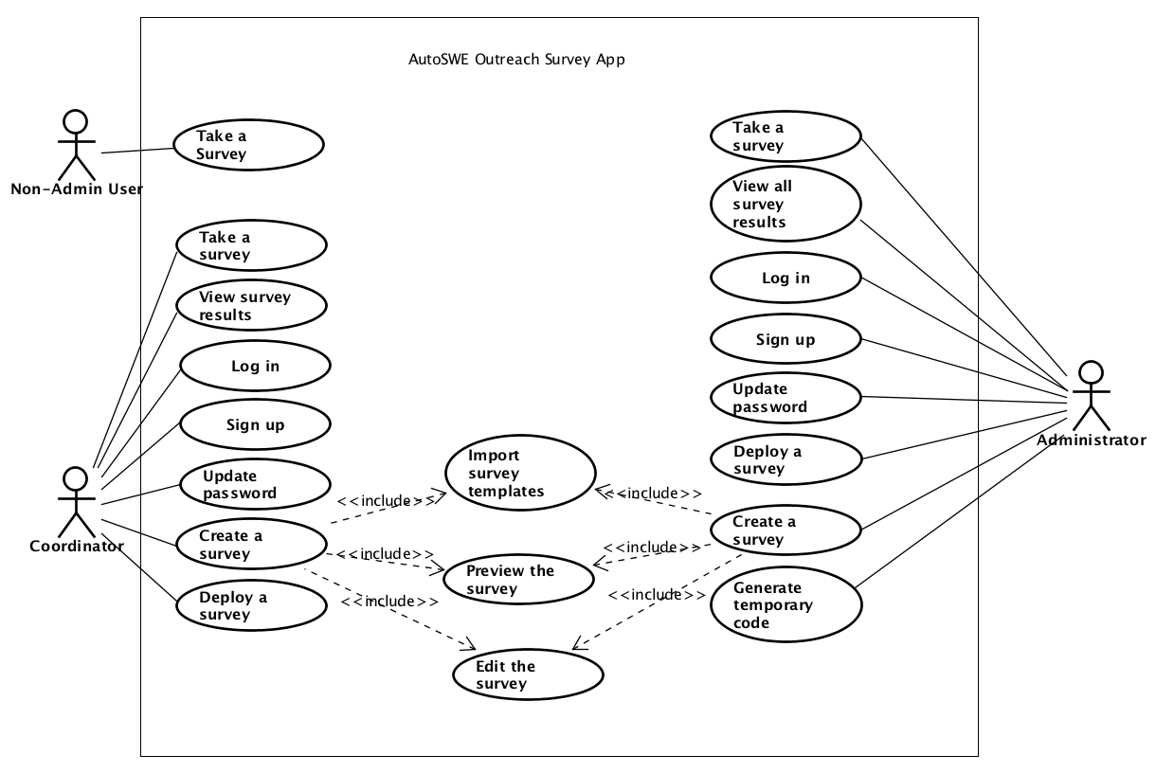
Use Case Diagram
Chapter 10. References

Slide 9
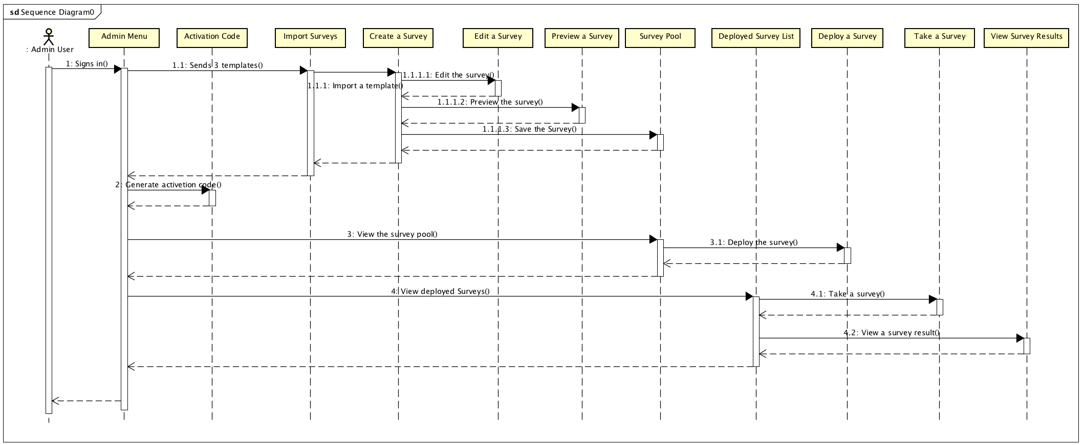
Sequence Diagram

Slide 10
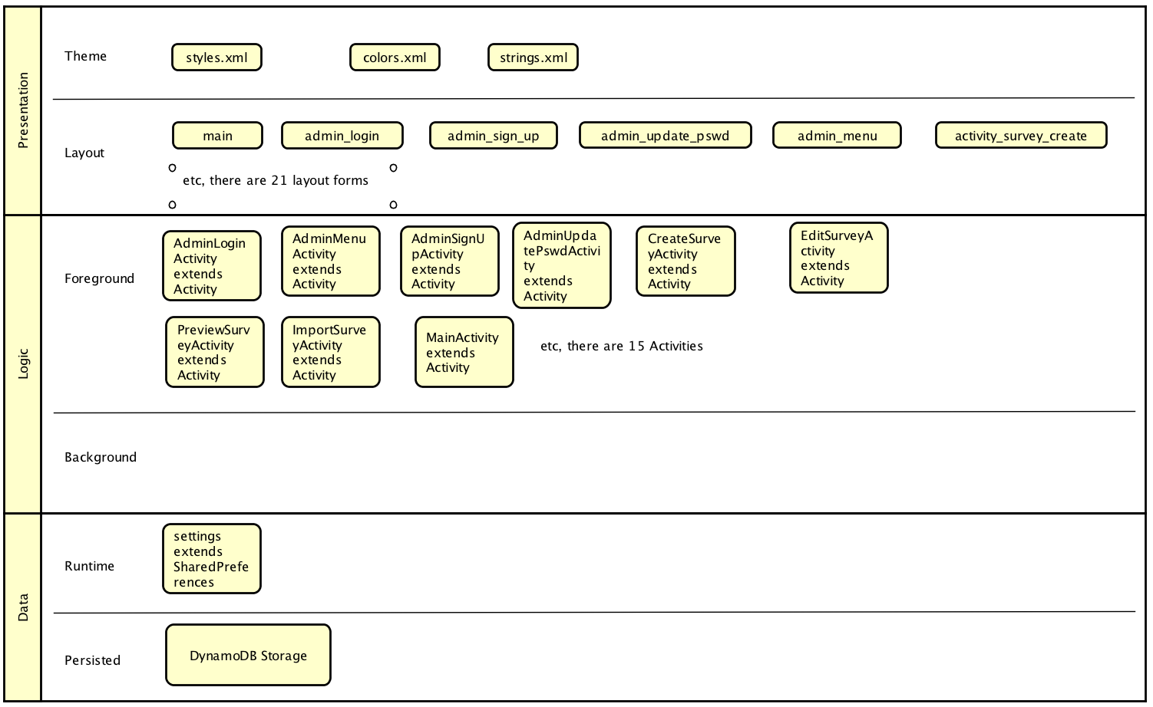
AutoSWE app Architecture

Slide 11
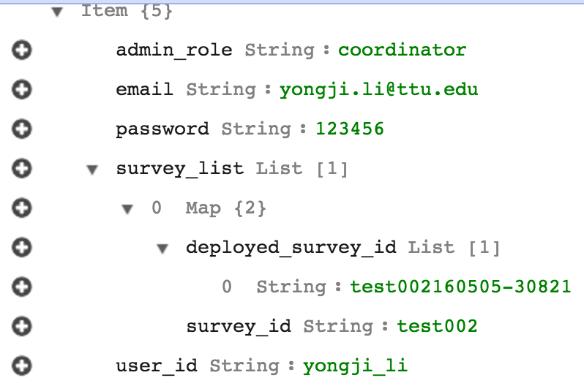
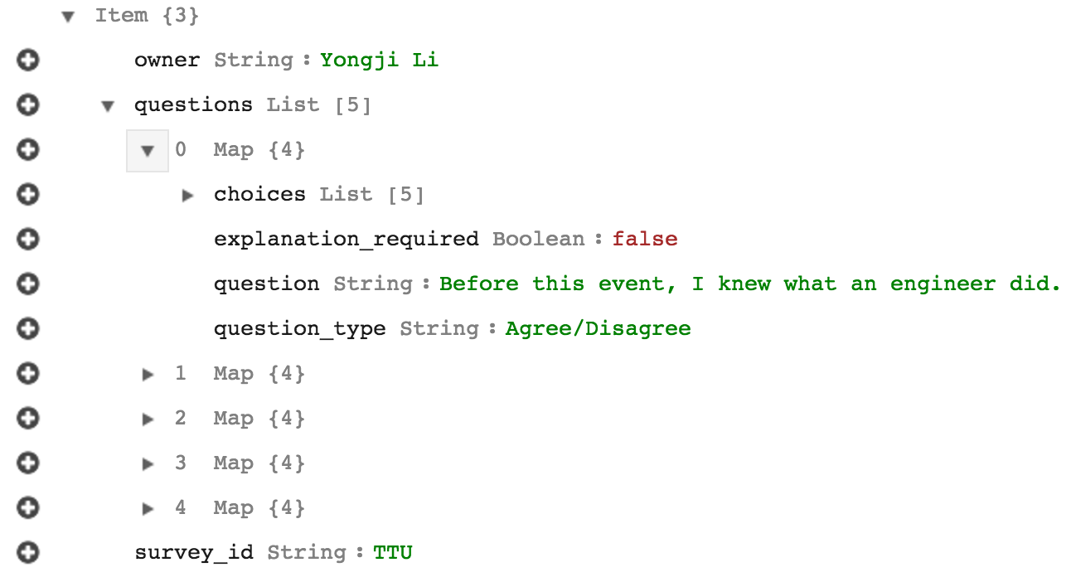
Database Design
Table: SWE_user
Table: survey, survey_templates and deployed_surveys

Slide 12
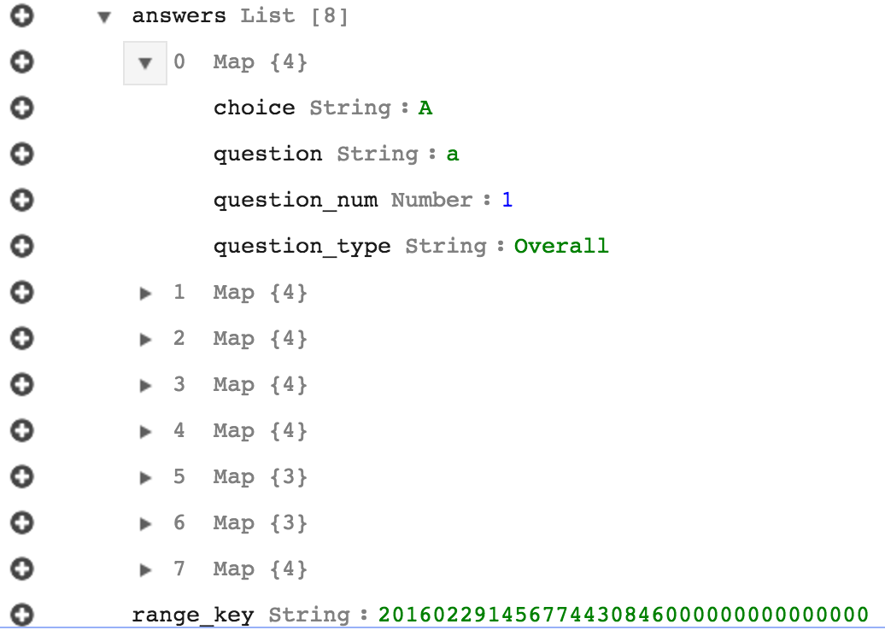
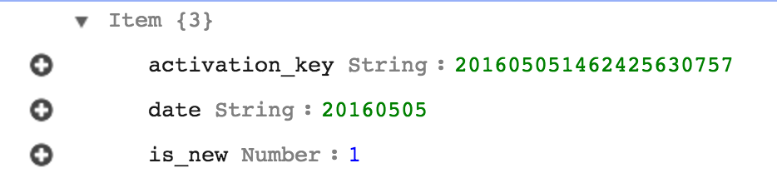
Database Design
Table: activation_code
Table: survey_results

Slide 13
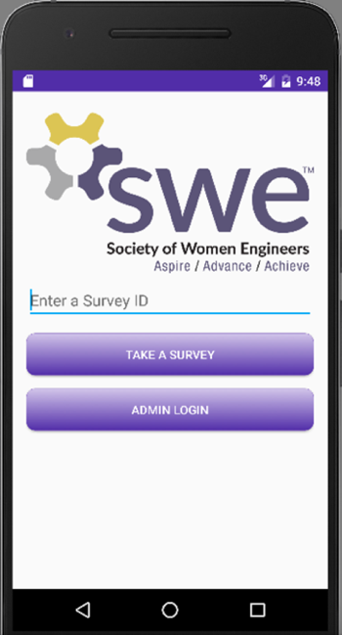
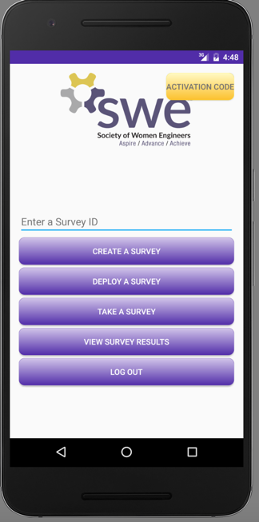
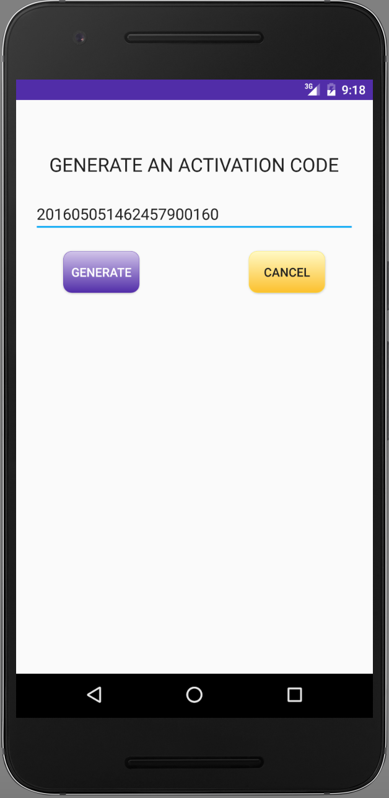
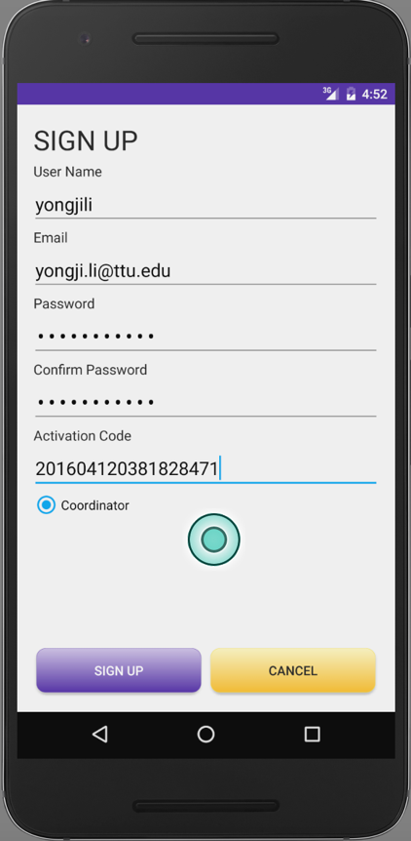
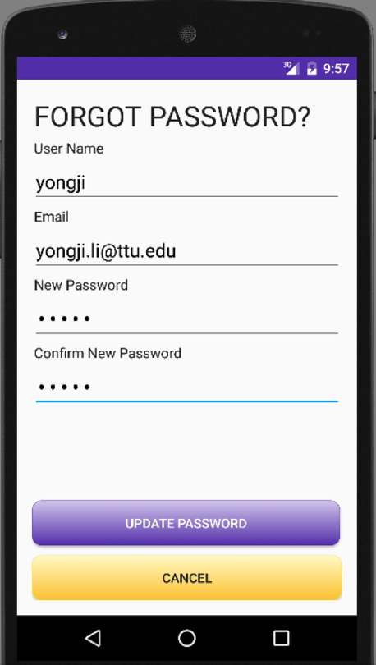
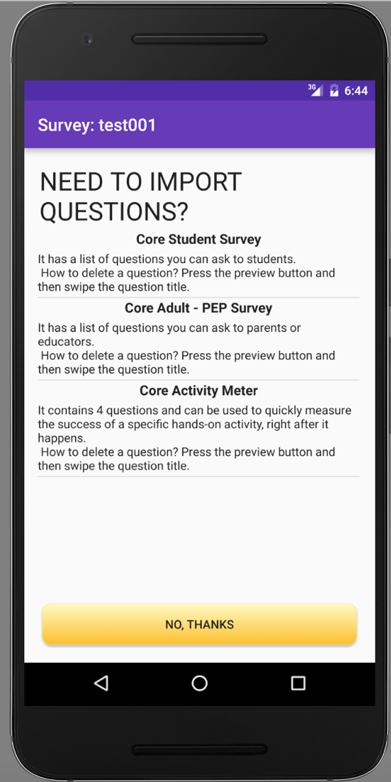
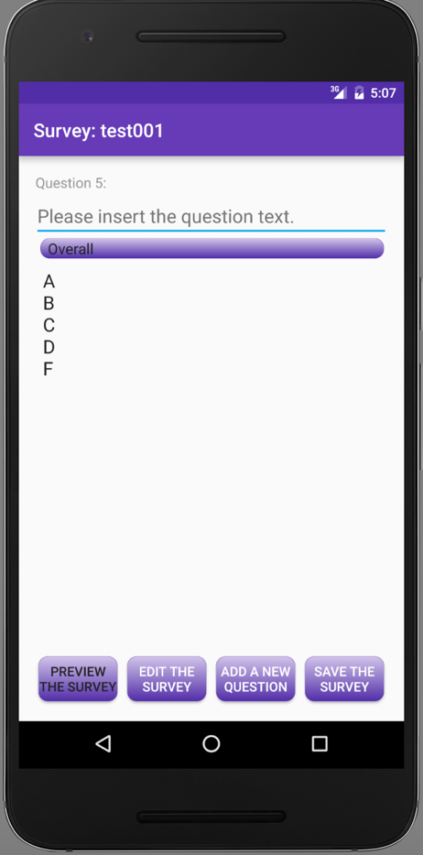
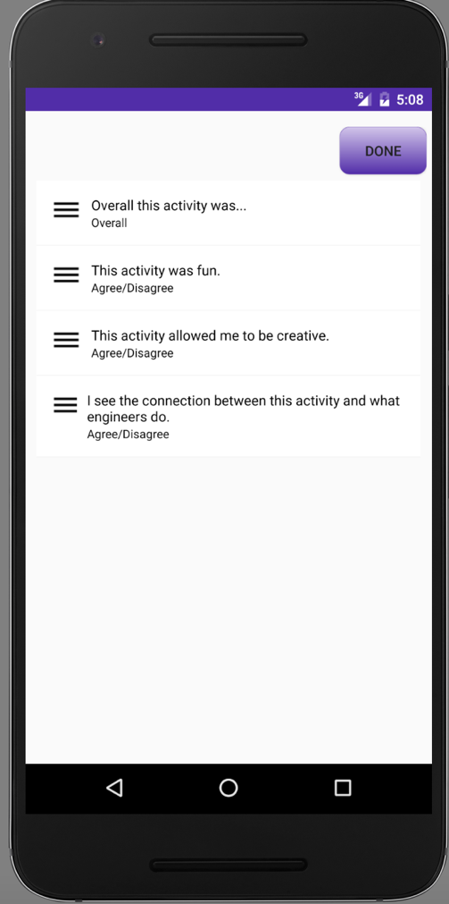
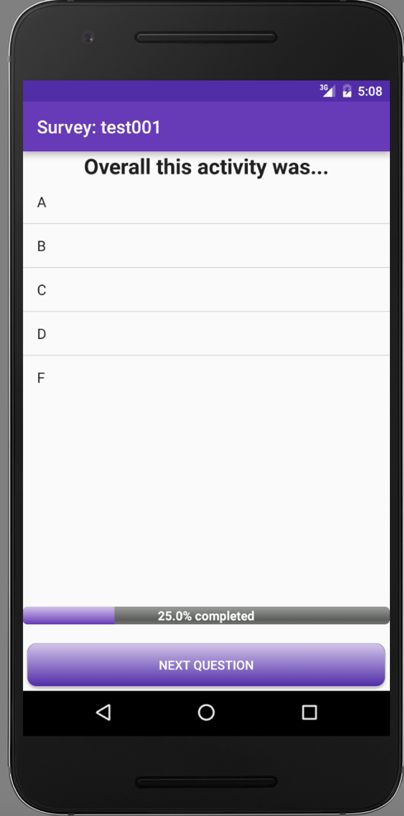
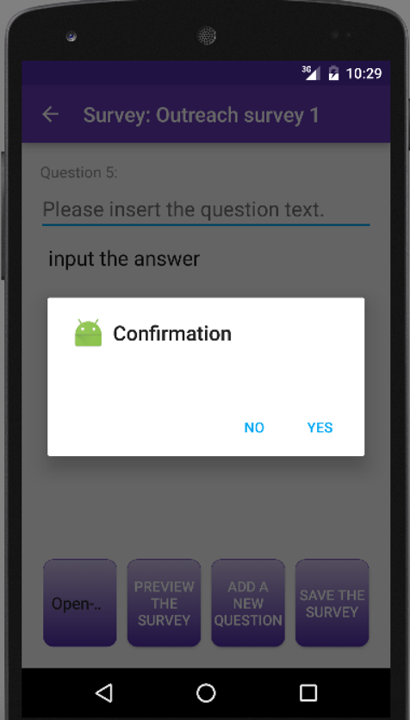
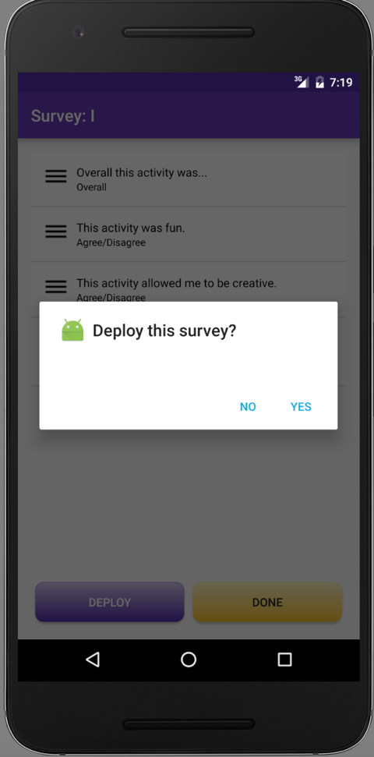
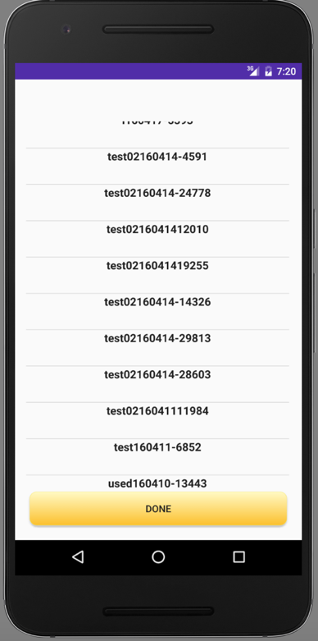
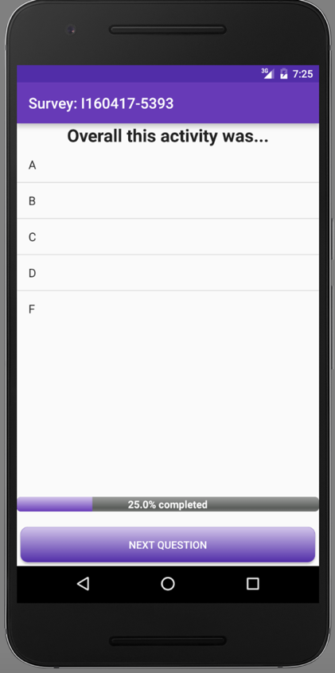
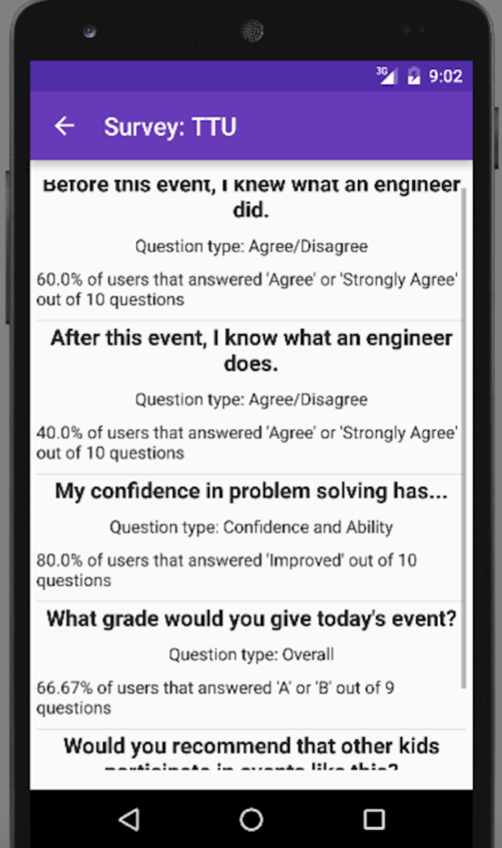
User Interface

Slide 14
Demo
Project Demo

Slide 15
Testing-functional Testing (Manual)
Code coverage
There are a number of coverage criteria, the main ones being:
Function coverage - has each function (or subroutine) in the program been called?
Statement coverage - has each statement in the program been executed?
Branch coverage - has each branch (also called dd-path) of each control structure (such as in if and case statements) been executed? For example, given an ifstatement, have both the true and false branches been executed? Another way of saying this is, has every edge in the program been executed?
Condition coverage (or predicate coverage) - has each boolean sub-expression evaluated both to true and false?

Slide 16
Testing-functional Testing (Automated)
Download Espresso
Make sure you have installed the latest Android Support Repository under Extras (see instructions).
Open your app’s build.gradle file. This is usually not the top-level build.gradle file but app/build.gradle.
Add the following lines inside dependencies:
androidTestCompile ‘com.android.support.test.espresso:espresso-core:2.2.2’ androidTestCompile ‘com.android.support.test:runner:0.5’See the downloads section for more artifacts (espresso-contrib, espresso-web, etc.)
Set the instrumentation runner
Add to the same build.gradle file the following line in android.defaultConfig:
testInstrumentationRunner “android.support.test.runner.AndroidJUnitRunner”

Slide 17
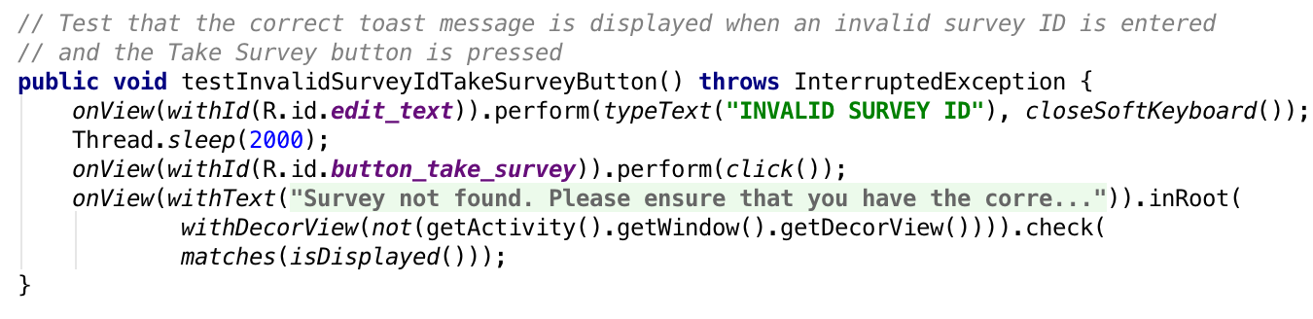
Testing-functional Testing (Automated)
How to use it?

Slide 18
Testing-Usability Testing
1. For security reason, it’s better to add password policy: 6-20 characters, a combination of letters and numbers, at least one UPPERCASE letter.
2. When taking a survey, I cannot go back to the previous question.
3. In the “edit the survey” activity, some users may not be aware that they can reorder or delete the questions.
4. Save the survey and then edit it later.

Slide 19
Future Work
Login using SWE Database
Generate a PDF file for surveys and survey results.
View surveys by region and chapter
The same app built for iOS

Slide 20
References
https://www.udacity.com/course/developing-android-apps--ud853
http://societyofwomenengineers.swe.org/about-swe
http://docs.aws.amazon.com/mobile/sdkforandroid/developerguide/
https://github.com/bauerca/drag-sort-listview
http://developer.android.com/guide/index.html
http://stackoverflow.com/questions/22553672/android-startactivityforresult-setresult-for-a-view-class-and-an-activity-cla
http://androidux.com/
https://www.google.com/design/icons/index.html#ic_warning
Getting a Result from an Activity: http://developer.android.com/training/basics/intents/result.html#ReceiveResult
Set up the AWS Mobile SDK for Android: http://docs.aws.amazon.com/mobile/sdkforandroid/developerguide/setup.html
5 free tools for load testing your website and apps: http://codecondo.com/load-test-website-apps-online/

Slide 21

Questions?

